Slide 1
APTIS GENERAL
WRITING

Slide 2




Table of contents
Bài viết APTIS part 4
Những lưu ý khi làm bài
Đề mẫu
Hướng dẫn trả lời
Luyện tập
https://edulife.com.vn/

Slide 3

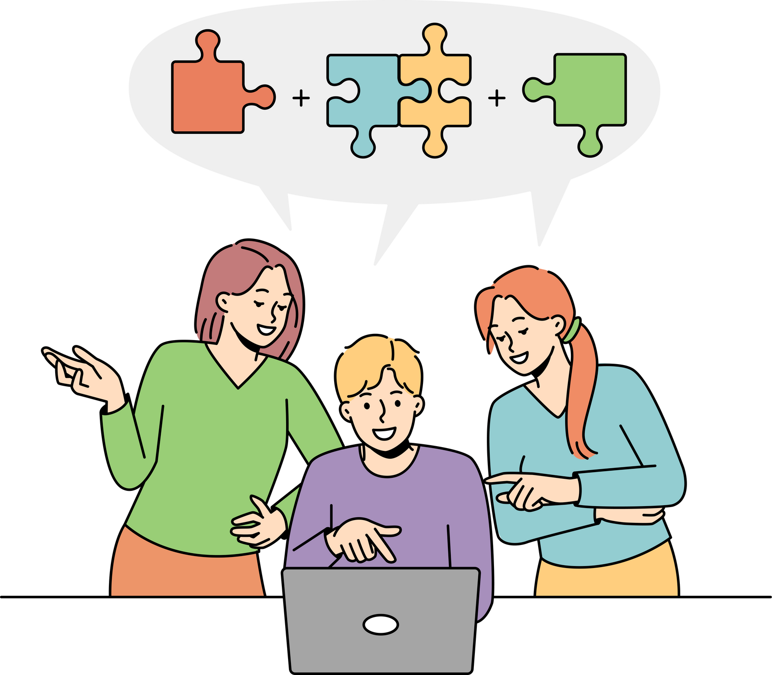
01
Bài viết APTIS part 4
https://edulife.com.vn/

Slide 4



Bài viết APTIS part 4
Viết thư văn phong thông thường và trang trọng
40-50 từ với thư thông thường
120-150 từ với thư trang trọng
Thư thông thường – 10 phút
Thư trang trọng – 20 phút

Slide 5

Văn phong
Trang trọng
Thông thường
Ngôn ngữ trang trọng, lịch sự.
Không dùng từ lóng, viết tắt.
Ngôn ngữ cởi mở, thoải mái.
Có thể dùng từ long, từ địa phương, viết tắt.

Slide 6

02
Những lưu ý khi làm bài
https://edulife.com.vn/

Slide 7
Lưu ý khi làm bài
Đọc và hiểu đúng câu hỏi
Trả lời đúng trọng tâm, văn phong phù hợp
Ngữ pháp và từ vựng phong phú, chính xác
Đảm bảo tính mạch lạc, liên kết
Kiểm soát số lượng từ

Slide 8

03
Đề mẫu
https://edulife.com.vn/

Slide 9
Đề mẫu
You are a member of a music club. You received this email from the club.
Dear members,
Recently, our club has had some concerts and plays music at night. However, residents living near our club complain about the noise from our concerts. Please give me some suggestions to solve this problem.
Write an email to your friends. Write about your feelings and ask for advice on how to deal with them. Write about 50 words. You have 10 minutes.

Slide 10
Đề mẫu
You are a member of a music club. You received this email from the club.
Dear members,
Recently, our club has had some concerts and plays at night. However, residents living near our club complain about the noise from our concerts. Please give me some suggestions to solve this problem.
Write an email to CLUB, write about your feelings and to find a solution. Write
about 120-150 words. You have 20 minutes.

Slide 11

04
Hướng dẫn trả lời
https://edulife.com.vn/

Slide 12
Bố cục bài viết thư thông thường
Chào hỏi: Hi + tên
Câu đầu: How’s it going?
Mục đích viết thư: Have you heard about the news that…
Cảm xúc của bản thân: I’m so (annoyed/ disappointed) about …
Đưa ra gợi ý: Do you think we should …
Kết thư: Anyway, I should get going as I have a busy day.
Dòng cuối: Don't forget to drop me a line soon!
Tên của mình

Slide 13
Đề mẫu
Hi Sam,
It’s Mary. How’s it going? Have you got the email from our club that residents living near our club complain about the noise from our concerts? I feel so sad and worried about this. Do you think we should change the time and place for the concerts? Let’s discuss it over lunch. Anyway, I should get going as I have a busy day. Don't forget to drop me a line soon!
Love,

Slide 14
Bố cục bài viết thư trang trọng
Chào hỏi: Dear Sir/ Madam/ Manager
Lí do viết thư: My name is Yen, a member of your music club. I am writing in response to the latest email from our club.
Cảm xúc của bản thân: To be honest, I feel/am (worried about this). I think most of the members in our club will share my sentiments about …
Đưa ra gợi ý: There are several solutions we can consider.
Kết thư: Hopefully, my suggestions/solutions will be somewhat useful to our club
Dòng cuối: I would appreciate a prompt reply to this letter.
Ký tên: Yours faithfully/ Yours sincerely

Slide 15
Đề mẫu
Dear Sir/ Madam,
My name is Yen, a member of your music club. I am writing in response to the latest email from our club.
According to the news, residents living near our club have complained about the noise from our concerts. I feel sad and worried to hear that news because it negatively affects our club's image, and I believe that most of the members in our clubs will share my sentiments. Therefore, it is high time we did something to fix this problem or at least improve the situation.
There are several solutions we can consider. First, we can install some devices that can reduce the noise. It is better to get advice from those who are experts in this field because they have experience and expertise to tackle such problems. Second, we can offer free tickets or send invitations to the residents. Last, we can change the timing or the locations of the concerts.
I would appreciate a prompt reply to this letter.
Yours faithfully,

Slide 16
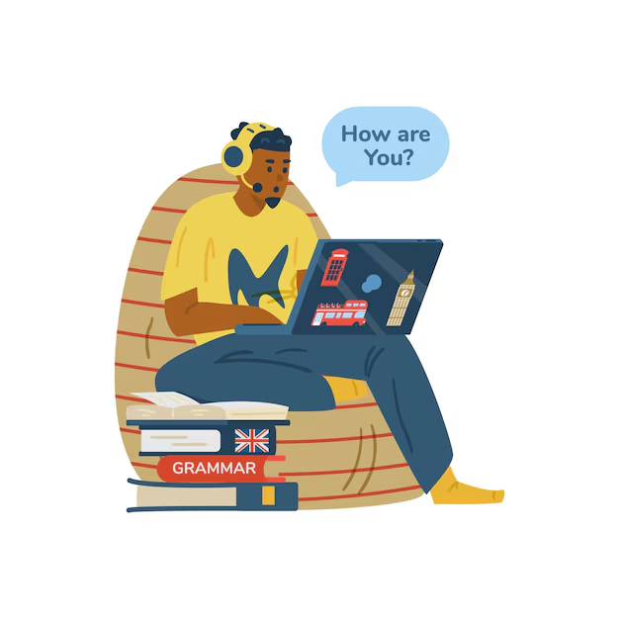
05
Luyện tập

Slide 17
Cảm ơn các bạn đã chú ý theo dõi!
Hẹn gặp lại các bạn ở những bài học tiếp theo

